Slide 1
Multithreaded
Programming

Slide 2


Slide 3

Process vs Thread
Order 2
Recipe
Step 1
Step 2
Step 3
...
Order 1
Recipe
Step 1
Step 2
Step 3
...
Restaurant (A CPU Core)
Chef (thread)
Kitchen (Process)
Restaurant (A CPU Core)
Shelves (Memory)
Kitchen (Process)
Shelves (Memory)
Chef (thread)
4
2
3
1
Chef (thread)
Chef (thread)

Slide 4
Process vs Thread
Restaurant (A CPU Core 1)
Restaurant (A CPU Core 2)
Kitchen (Process)
Kitchen (Process)
Shelves (Memory)
Shelves (Memory)
Chef (thread)
Chef (thread)
Chef (thread)
Chef (thread)
Chef (thread)
Kitchen (Process)
Kitchen (Process)
Shelves (Memory)
Shelves (Memory)
Chef (thread)
Chef (thread)
Chef (thread)
Chef (thread)

Slide 5
Multi-tasking
Process based | Thread based
Heavy weight | Light weight
Program in execution is called as a process. | Thread is a part of the program that has separate path of execution.
Each process has a separate space in memory | Threads share the same address space
Communication cost is high | Communication cost is low
Context switching is required for saving and loading registers, memory maps etc. | Context switching is not required.
Eg. Browsing and listening to music | Eg. Formatting using a text editor at the same time it is printing.

Slide 6
Concurrency Vs Parallelism
Concurrency is the task of running and managing the multiple computations at the same time.
While parallelism is the task of running multiple computations simultaneously.
Concurrency is achieved through the interleaving operation of processes on the central processing unit(CPU) or in other words by the context switching.
While it is achieved by through multiple central processing units(CPUs).
3.Concurrency can be done by using a single processing unit.
While this can’t be done by using a single processing unit. it needs multiple processing units.

Slide 7
Single vs Multi Threading
code
data
files
code
data
files
registers
stack
registers
registers
registers
stack
stack
stack
thread
thread
single-threaded process
multi-threaded process

Slide 8
Thread Model
Single threaded systems use event loop with polling
Threads run a infinite loop
It polls a single event queue, let say, waiting for a network file to be read
The program wait until the event handler returns which wastes the CPU time.
When a thread blocks for a resource, entire program stops running

Slide 9
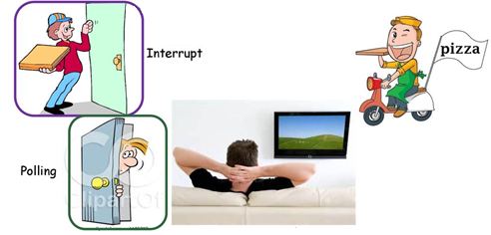
Example

Slide 10
Polling vs. Interrupts
Chef A
Chef B
Chef A
Chef B
Chef A
Chef B
asking
asking
asking

Slide 11
Thread Model
All Java class libraries are designed with multithreading in mind.
Java Multithreading
Eliminates loop/polling mechanism
One thread can pause without stopping the other parts of the program
Eg. It allows animation loops to sleep for a second without causing the whole system to pause
One thread that is blocked pauses.

Slide 12
Thread States
Ready to run (New): As soon as it gets CPU time it will start running.
Running: Under execution.
Suspended: Temporarily not active or under execution.
Blocked: Waiting for resources.
Resumed: Suspended thread resumed, and start from where it left off.
Terminated: Halts the execution immediately and never resumes
new
new
start
ready
I/O complete, time-out, notify, resume
(dispatch)
yield
running
blocked
I/O, sleep, wait, suspend
terminate
dead

Slide 13
Multithreading
Main Thread
Thread 2
Thread 3
Time
Begin
End
Suspended/Resumed

Slide 14
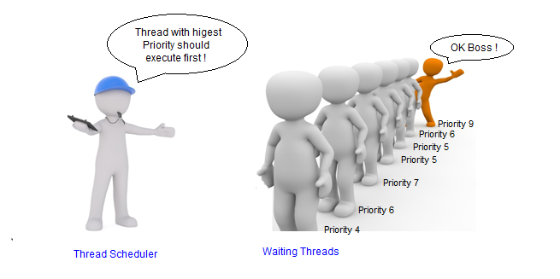
Thread Scheduler

Slide 15
Thread Priorities
Priorities determine how thread should be treated with respect to the others
Priorities are integers that specify relative priority of one thread to another.
Higher priority does not mean that the thread runs faster.
When switching from one thread to the next, the priority is used for deciding which one to choose next – context switch

Slide 16
Rules determining Context Switch
A thread can voluntarily relinquish control
When explicitly yielding, sleeping or when blocked
The highest priority thread that is ready to run is given the CPU
Non-preemptive multitasking
A thread can be preempted by a higher priority thread
When a lower priority thread that does not yield the processor is simple preempted by a higher priority thread no matter what it is doing
As soon as the higher priority thread want to run, it does
Preemptive Multitasking
Some operating systems, time slice equal priority threads in round robin fashion. For others, thread should voluntarily yield otherwise it will not run.

Slide 17
Pre-emptive vs Non-preemptive Scheduling
Thread1
Thread1
Thread1
Thread1
switch
switch
interrupt
switch
switch
interrupt
switch
interrupt
switch
switch
interrupt
switch
preemptive
Non preemptive

Slide 18
Context Switching w.r.t. Processes and Threads
Threads
Values of registers, PC, stack pointer must be changed
Memory management information need not be changed because they share the same virtual address space
No system calls are required for cooperating among threads
Processes
Requires all the above.

Slide 19
Thread class
Method | Meaning
getName | Obtain thread’s name
getPriority | Obtain thread’s priority
isAlive | Determine whether the thread still running
join | Wait for the thread to terminate
run | Entry point for the thread
sleep | Suspend a thread for a period of time
start | Start a thread by calling its run method

Slide 20
Main Thread
When Java program starts, the main thread starts running immediately
It is the thread from which other threads are created
Often, it is the last thread to finish execution, because it performs various shutdown actions
It is created automatically
but it can also be controlled through a Thread object
currentThread() method can be used to get a reference to the main thread

Slide 21
Thread.sleep()
Causes the current thread to suspend execution.
This makes the processor time available for other threads waiting for the CPU.
Two overloaded sleep methods
sleep(long millis)
sleep(long millis, int nanos)
Sleep period can be terminated by interrupts.
you cannot assume that invoking sleep will suspend the thread for precisely the time period specified.

Slide 22
Thread States
new
new
start
ready
I/O complete, time-out, notify, resume
(dispatch)
yield
running
blocked
I/O, sleep, wait, suspend
terminate
dead

Slide 23
Creating a Thread
Threads can be created in two ways:
Implementing the Runnable Interface
By creating a class that implements the Runnable interface
Only a single method run() needs to be implemented
Inside run(), define the code that the thread needs to perform
run() method can call other methods, use other classes and declare variables
Using Thread class constructor
Thread(Runnable threadObj, String tName)
Defines where the execution of the thread will begin.
New thread will begin execution only after we call the start()

Slide 24
Choosing an Approach
It is best to implement Runnable interface, if we are not overriding any of the other methods by the Thread class .
When you inherit Thread class, you will not be allowed to extend any other class.

Slide 25
Creating a Thread
It can be created in two ways
Extending the Thread class
Call to start()
- Then by creating the instance of the class
- The extending class must override the run() method which is the entry point for the new thread
begins the executions of the new thread

Slide 26
Thread Priorities
Priority of a thread is represented by a number between 1 and 10
Methods
public static int MIN_PRIORITY - 1
final void setPriority(int level)
Priority
constants
public static int NORM_PRIORITY - 5
final int getPriority()
public static int MAX_PRIORITY - 10

Slide 27
Thread Priorities
In theory, threads run concurrently.
In practice, most computers have a single CPU.
Threads run one at a time, giving an illusion of concurrency.
Scheduling – execution of multiple threads in some order.
Java runtime supports fixed priority scheduling and it is also preemptive.

Slide 28
Thread Priorities…
Runtime system chooses the highest priority thread for execution.
The scheduler chooses the highest priority thread among the available threads for running.
This thread runs until,
A thread with higher priority comes
it preempts the other threads and become runnable.
It yields or its run() exists.
OS supports time slicing, its time allotment has expired.

Slide 29
Equal Priority threads
Multi-tasking will be implemented by each OS differently
Time slicing with Round robin
First come first serve
For safety, threads should yield the control once in a while.
This ensures that every thread gets a chance in non-preemptive environment
Practically, threads do get a chance to run because threads encounter blocking due to i/o etc.
Don’t rely on OS scheduling capabilities.

Slide 30
Thread priorities
m1.setPriority(Thread.MIN_PRIORITY);
m2.setPriority(Thread.MAX_PRIORITY);

Slide 31
Sleep
public static void sleep(long mls) throws InterruptedException
Try starting thread twice.
Calling run method instead of start()

Slide 32
Join
The join() method waits for a thread to die. In other words, it causes the currently running threads to stop executing until the thread it joins with completes its task.
public void join()throws InterruptedException
public void join(long milliseconds)throws InterruptedException

Slide 33
getName(),setName(String) and getId()
public String getName()
public void setName(String name)
public long getId()
currentThread()

Slide 34
Using isAlive() & join()
Mostly we want the main thread to finish last
It is accomplished by calling sleep() within main() with a long delay to ensure that all the child threads are terminated prior to the main thread
Question: How will main know when the child terminates?
isAlive() – determines whether a thread has finished; returns true is the thread is still running
join() – this method waits until the thread on which it is called terminates.
Maximum amount of time we want a thread to wait can also be specified.

Slide 35
Using isAlive() & join()
Mostly we want the main thread to finish last
It is accomplished by calling sleep() within main() with a long delay to ensure that all the child threads are terminated prior to the main thread
Question: How will main know when the child terminates?
isAlive() – determines whether a thread has finished; returns true is the thread is still running
join() – this method waits until the thread on which it is called terminates.
Maximum amount of time we want a thread to wait can also be specified.

Slide 36
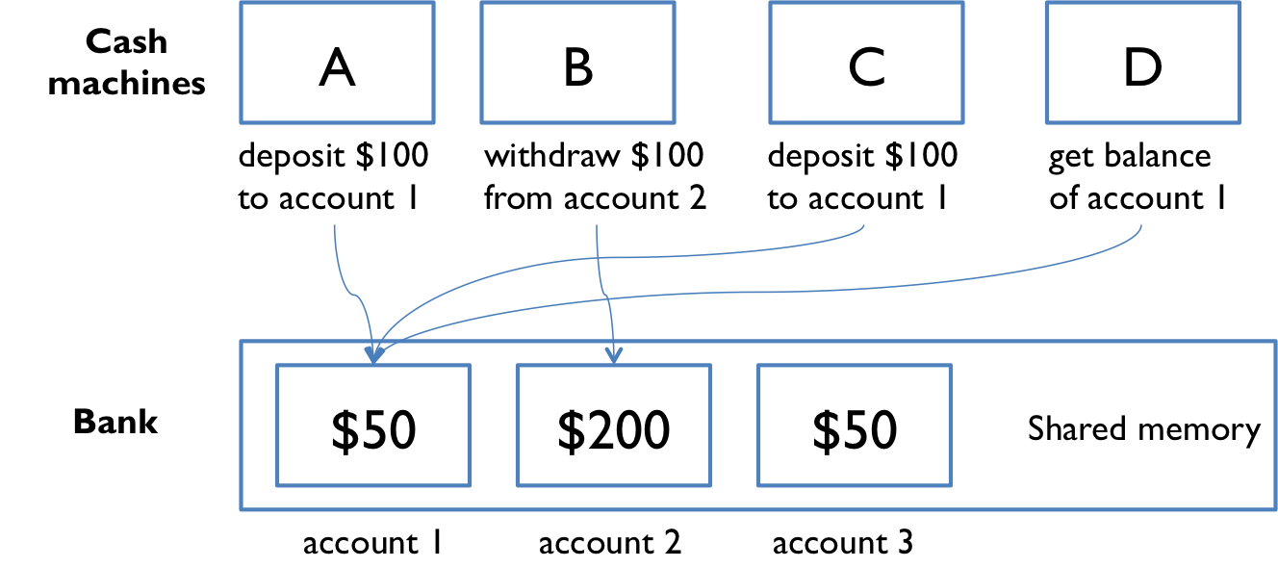
Shared Memory

Slide 37
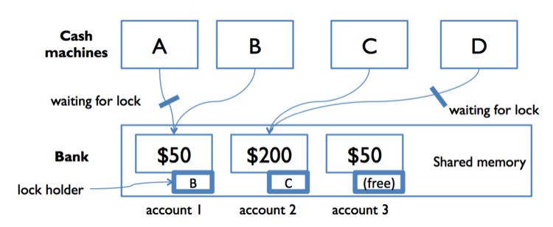
Shared Memory

Slide 38
Synchronization
When multiple threads try to access the same resource they often produce erroneous or unforeseen results.
Synchronization makes sure that only one thread can access the resource at a given point of time.
Using monitor which is an object that is used as a mutually exclusive lock
Only one thread can own the lock at a time
Thread can own a monitor, when it acquires a lock it is said to have entered the monitor, all the other threads attempting to enter the monitor are suspended until the thread inside exits.

Slide 39
Monitor
All objects have their own implicit monitor associated with them
To enter the monitor, the object has to call the method modified with the synchronized keyword.
All other threads trying to call it (or any other synchronized method) on the same instance has to wait.
Returning from the method relinquish the control to other waiting threads.

Slide 40
Synchronization
Creating synchronized methods within classes provides easy and effective way of achieving synchronization
If we want to synchronize objects of a class that was not designed for multithreaded access.
The class does not have synchronized methods
The class is provided by third party and we don’t have access to the code
Solution: Put call to the methods inside a synchronized block

Slide 41
Synchronization
Using Synchronized Methods
The synchronized Statement

Slide 42
Multi-threads
Thread 1
Thread 2
Statement 1 : T11
Statement 2 : T21
sleep
Statement 3 : T31
Statement 4 : T41
Statement 1 : T12
Statement 2 : T22
Statement 3 : T32

Slide 43
Race Condition
In multi-threaded environment, when more than one thread try to access a shared resource (modify, write) at the same time.
Since multiple threads try to race each other to finish executing a method thus the name race condition.
It is safe if multiple threads are trying to read a shared resource as long as they are not trying to change it.

Slide 44
Inter-thread Communication
Synchronized blocks unconditionally blocks all the other threads from asynchronous access
More subtle level of control can be achieved through interprocess communication
Multithreading is used to replace polling. Polling is implemented by a loop that is used to check a condition repeatedly. Once the condition is true, appropriate action is taken. This wastes CPU time.
Eg. Producer / Consumer problem

Slide 45
Wait, notify, notifyAll()
wait( ) tells the calling thread to give up the monitor and go to sleep until some other thread enters the same monitor and calls notify( ) or notifyAll( ).
notify( ) wakes up a thread that called wait( ) on the same object.
notifyAll( ) wakes up all the threads that called wait( ) on the same object. One of the threads will be granted access.

Slide 46
IPC methods
wait() – tells the calling thread to give up the monitor and go to sleep until some other thread enters the same monitor and calls notify() or notifyAll().
notify() – wakes up a thread that called wait() on the same object.
notifyAll() – wakes up all the threads waiting on the same object.

Slide 47
Difference between the sleep and yield methods
Similarity
Both are static methods and operate on the current thread
Both get CPU back from the thread to thread scheduler
Both relinquish CPU from current thread, but does not release any lock held by the thread.
If the locks are to be released along with the CPU, then use wait() method.
Difference
Sleep is more reliable because when yield is used there is a possibility of same thread getting the CPU
It is advisable to use Thread.sleep(1) instead of yield.

Slide 48
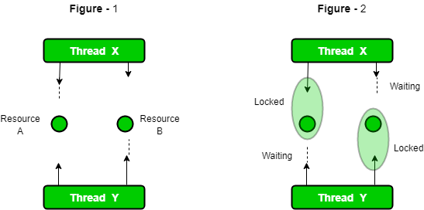
Deadlock

Slide 49
Suspend, Resume, Stop
suspend(), resume(), stop() – are used to pause, restart and terminate a thread
But, they are deprecated because they can sometimes cause serious failures.
wait() and notify() methods can be used to suspend and resume thread using a Boolean flag
Notes:
‹#›

